Slide 1




Care you can count on
Notes:
Biffa branding

Slide 2






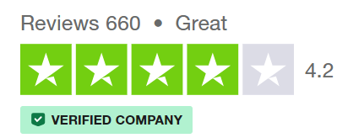
Instant Access to Expert Healthcare
Appointments available 24/7, 365 days a year.
Speak to a clinician on video or phone call – wherever you are.
Appointments within 2 hours.
Fast access to prescriptions to suit your needs, delivered or collected from a local pharmacy of your choice.
Private referrals, fit notes and medical letters.
Works alongside NHS GP.
Add Dependants Add your Partner/Dependants (if included in your benefit).
Notes:
Jazz it up

Slide 3

Speak to the Right Clinician
GPs
Expert advice without the waiting room
Advanced Clinical Practitioners
Convenient care for everyday health needs
Physiotherapists
Fast track recovery from pain or injury with digital exercise plans
Mental Health Practitioners
Confidential, compassionate care
Notes:
Jazz it up

Slide 4


What Can We Treat?
Allergies and intolerances
Headaches and migraines
Cold, flu and minor illnesses
Joint and muscles
Lifestyle Support
Mental Health and Wellbeing
Sexual Health
Skin Conditions
Women’s Health
Men’s Health
Gut Health
While we treat a wide range of conditions, Doctor Care Anywhere is not an emergency medical service. If you think you have a medical emergency, you must call 111 or 999, or visit your nearest Emergency Department.

Slide 5
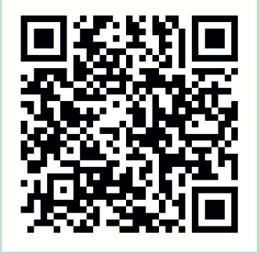

Activate Your Account Now
Once we have received your details from your employer you will receive an email invitation from DCA, containing your unique Activation Code
e.g. 123456
Set up your account and be ready for when you need to book an appointment!
Scan QR Code

Slide 6
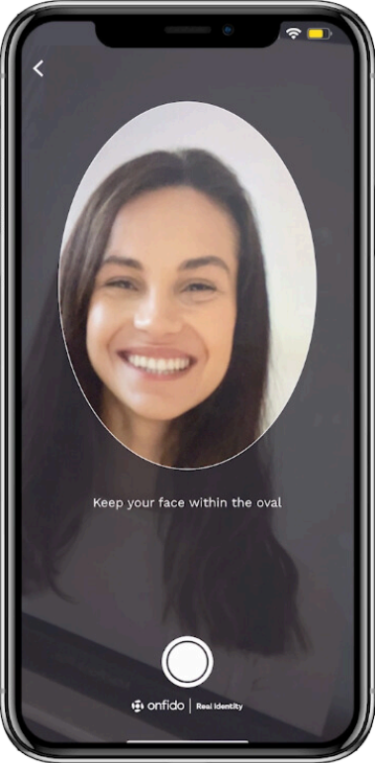

How To Verify:
We ask patients to verify for clinical safety reasons so that we know we are treating the correct individual and creating an accurate medical record.
To verify your identity, you’ll need a valid photo ID. You’ll be asked to take a selfie (a photo of yourself), which will be compared to the photo on your ID.
Accepted forms of ID include:
Passports
Photo Driver’s Licenses
National Identity Cards
It’s best to verify your identity as soon as you register. Your account must be verified before booking an GP or Advanced Clinical Practitioner (ACP) appointment for yourself .

Slide 7


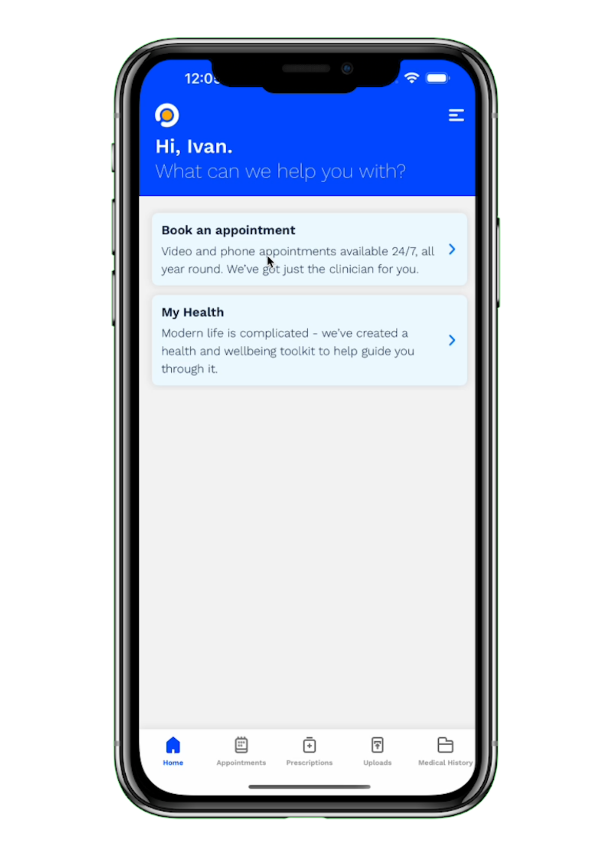
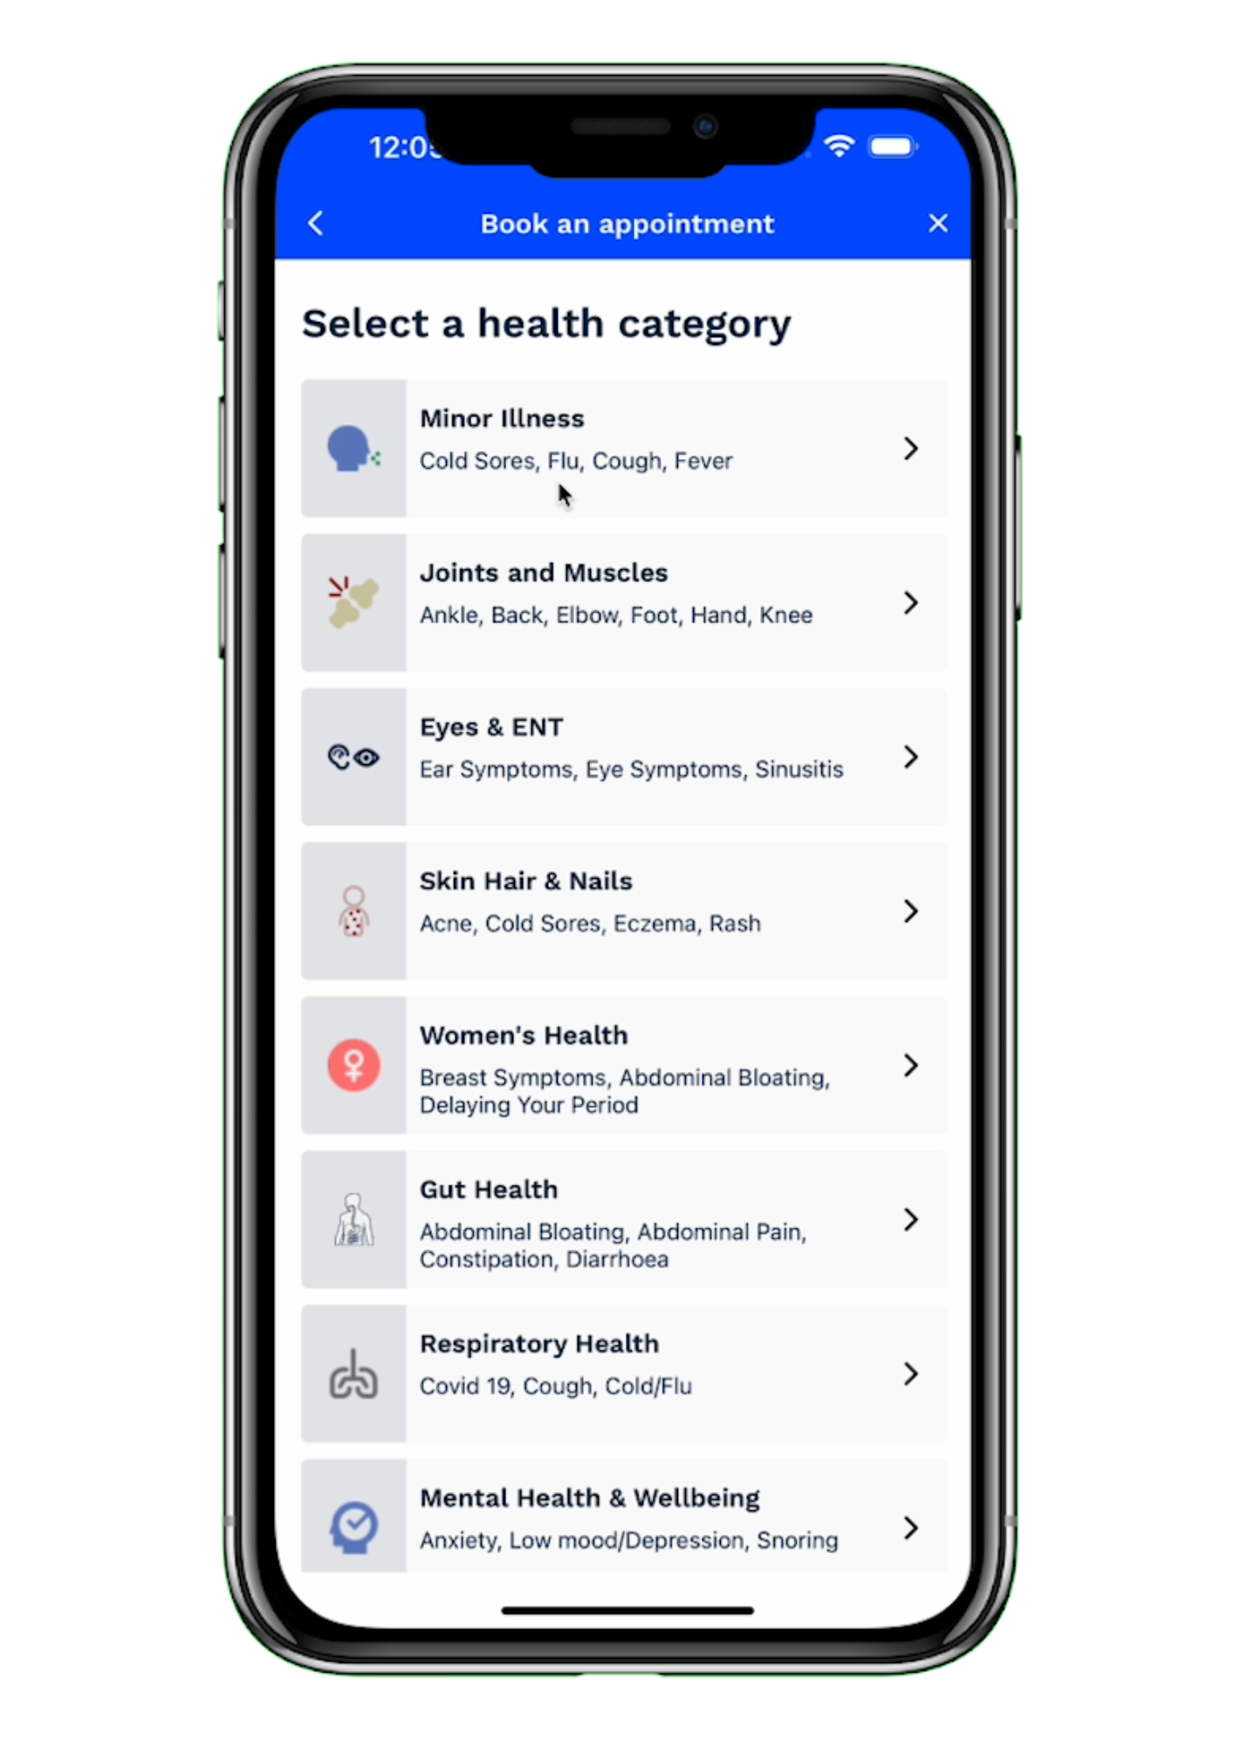
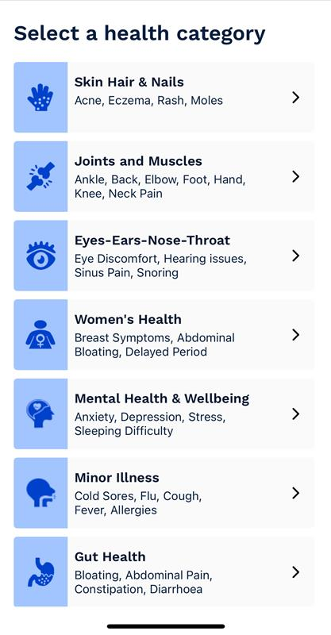








Our Patient Journey
Open the App
Choose health concern
Consultation
Outcomes
Included in Membership
Prescription
Fit notes
Open referral
Physiotherapy sessions
Personalised care plans
Self-Pay
Medication
Mental Health Support
Scans or diagnostics
Medical Letters
GP
ACP
Mental Health Practitioner
Physiotherapist
Notes:
Our booking journey enables rapid access to care through a clinically guided, evidence-based digital “front door”
You can see from this slide that your members would log-in to their account > select a health category > consultation is then booked with the most appropriate and available clinician.
The booking system also selects the most appropriate clinician type for the selected health concern, but patients can still choose if preferred.
Members have the option to chose next available appointment or select a time and date that works best for them.
The outcomes are dependent on health concern but for example:
Prescriptions: With our exclusive arrangement with Uber we will have the ability to deliver a prescription to your members within an hour, this is perfect for your time poor members.
Digital Mental AI Coach: our partnership with HelloSelf enables us to prescribe a digital Al supported mental health coaching programme that drives weekly check-ins and engagement with members, making them feel like they are getting instant support
Digital MSK – we recognise that your members suffer with MSK disorders and so that ability to see a First Contact Physio and be prescribed a digital exercise programme give them peace of mind that they are getting their issue resolved
There are a number of benefits to Wesleyan of offering this service to its members, these include:
Engaged member base – we have a wealth of experience in targeting different audiences, as an example our recent launch with Biffa mean that we had to drive awareness to a workforce that are out on the field with limited access to emails etc. We also work closely with AXA and drive engagement through different personas to make it feel more personalised. We would be able it use this experience with Wesleyan to drive different message to different audiences
Differentiated offering – we feel that our service stands out above our competitors as we are truly 24/7, we have appointments up to 20 mins, we treat children as well as adults, we have our exclusive prescription service offering and we also retain 98% of our direct client contracts demonstrating that we truly deliver on our partnership promise.
Increased member retention will be delivered because you have listened to your members via the insights research you did and are offering them a health & wellbeing service that meets their needs
By including this digital healthcare benefits Wesleyan will have a great additional tool that can be utilised on marketing promotions and as stated we can help support on this
Finally, DCA have a constant product improvement and innovation cycle that we be covered later in the presentation, but Wesleyan can be confident that we will always be looking to make service enhancements for their members
DCA are also keen to work with Wesleyan on embedding this journey into the Wesleyan app to make a seamless experience which we will cover a little later.

Slide 8

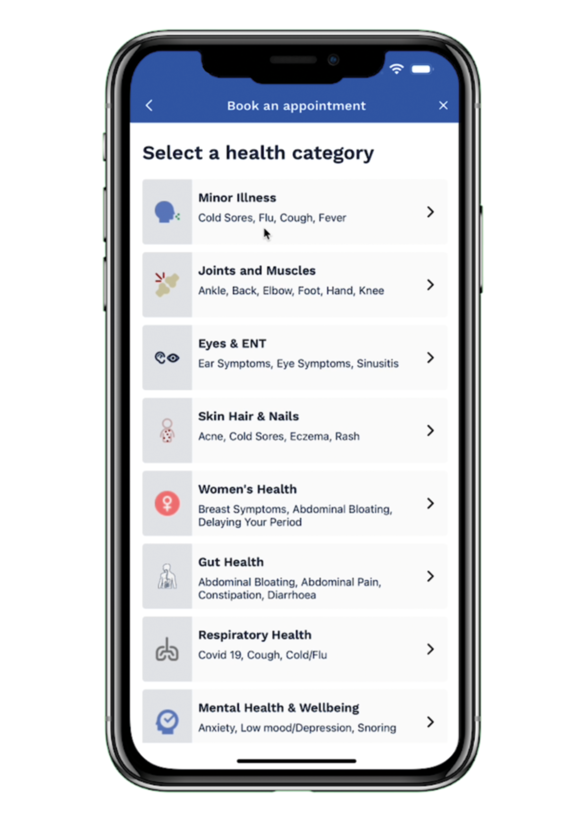
How to book a clinician appointment
Book appointments within 90 seconds from your phone.
24/7 availability, wherever you are.
GPs, Advance Nurse Practitioners, Mental Health Practitioners and Physiotherapists
Play video

Slide 9
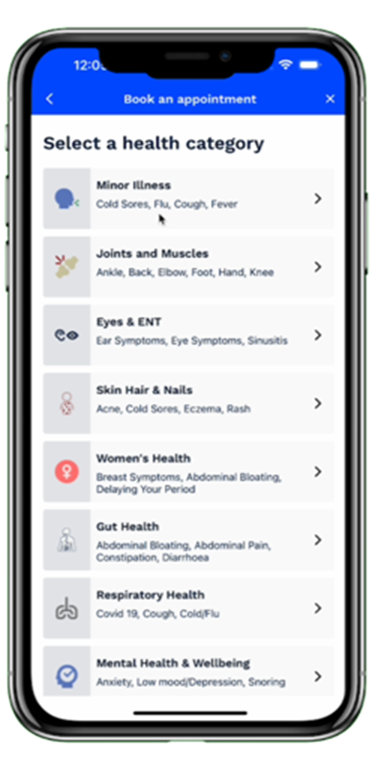
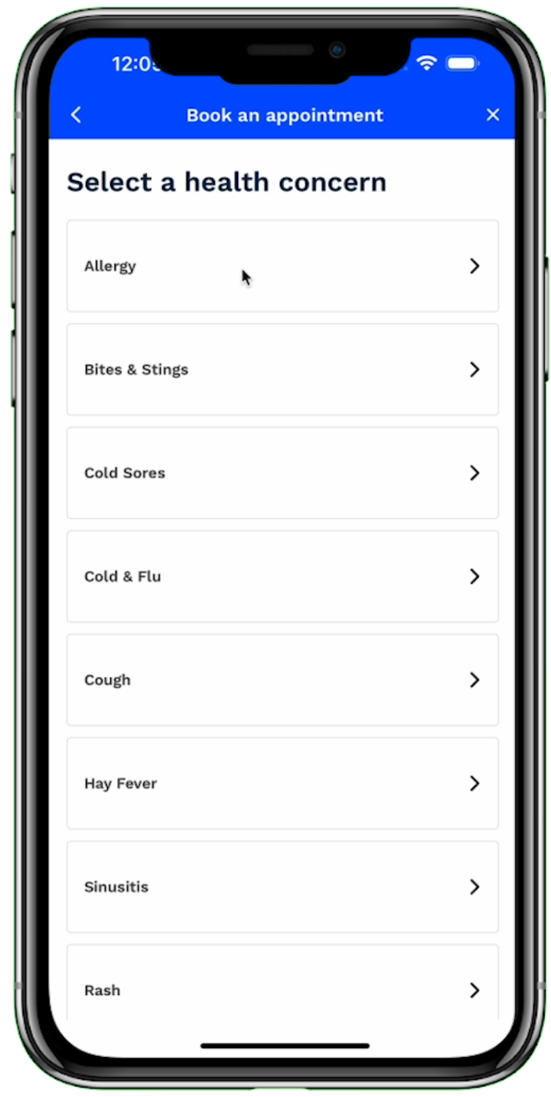
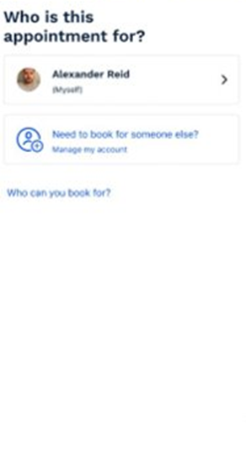
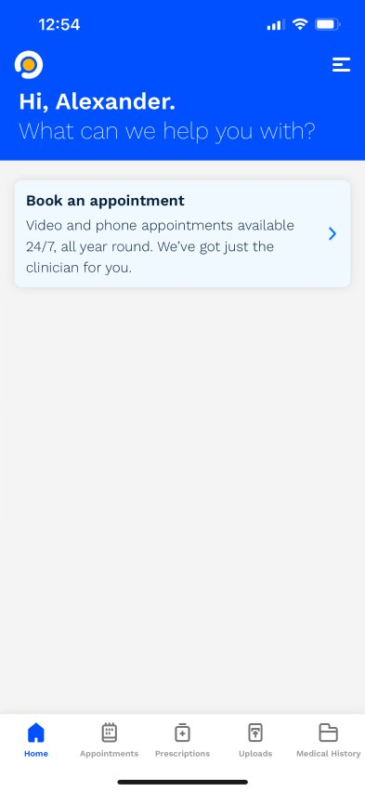
How does it work?
Patient logs onto app and selects "Book an appointment” from the homepage.
Patient selects who the appointment is for.
The patient selects their health category from the choices provided.
Patient picks the health concern that aligns with their symptoms.

Slide 10
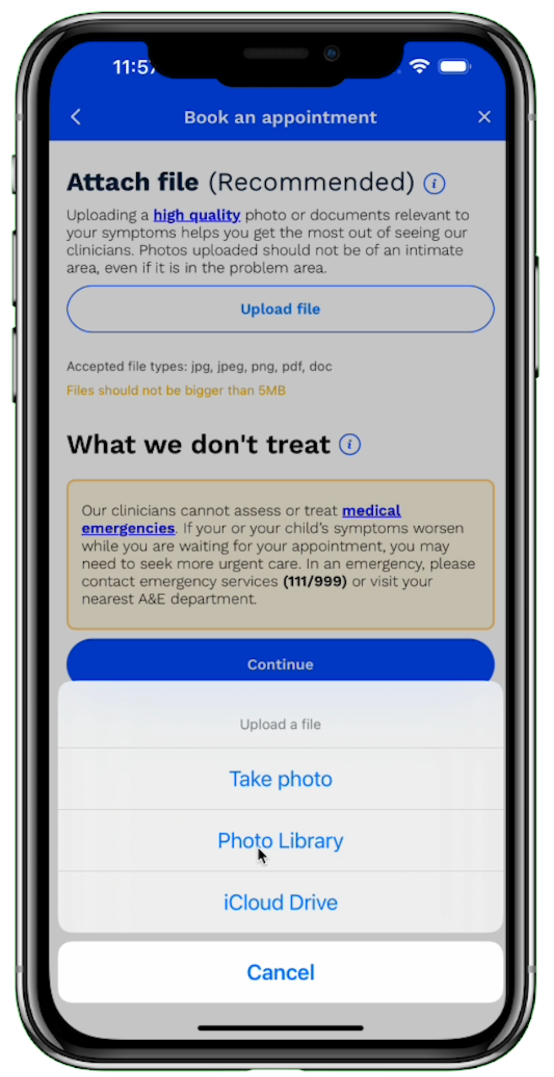
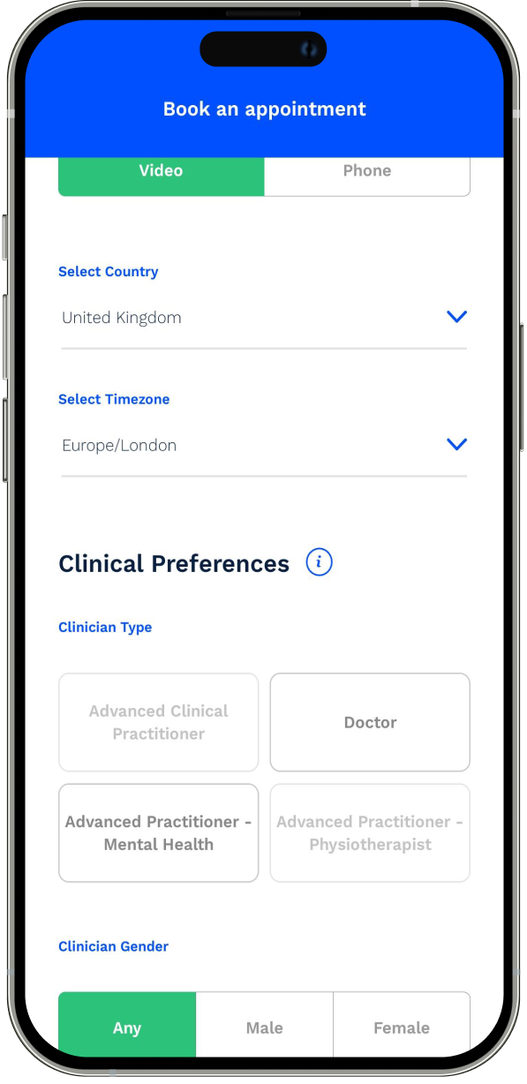
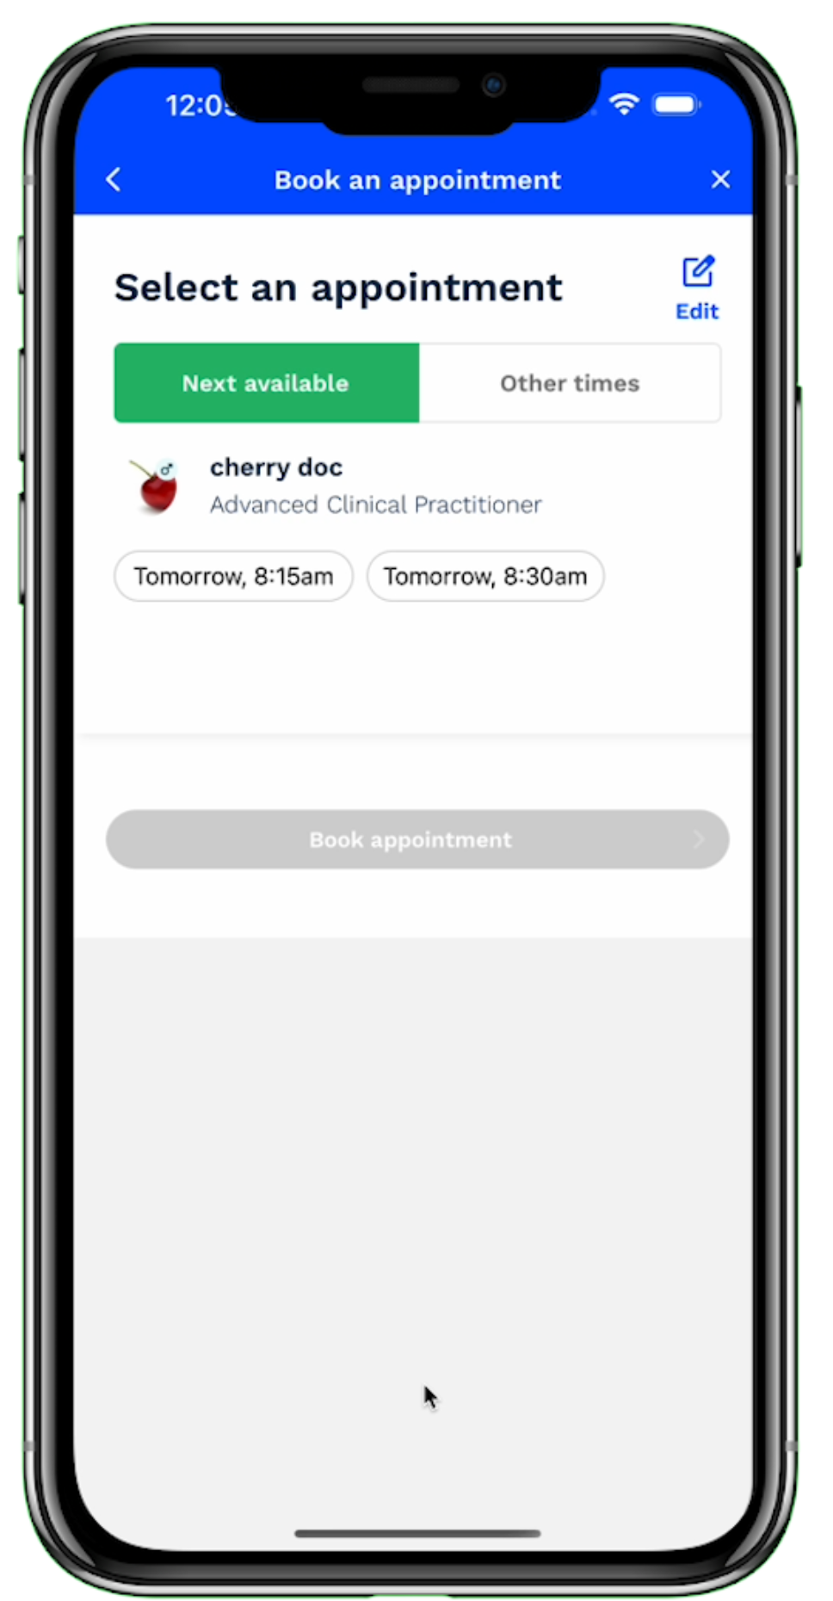
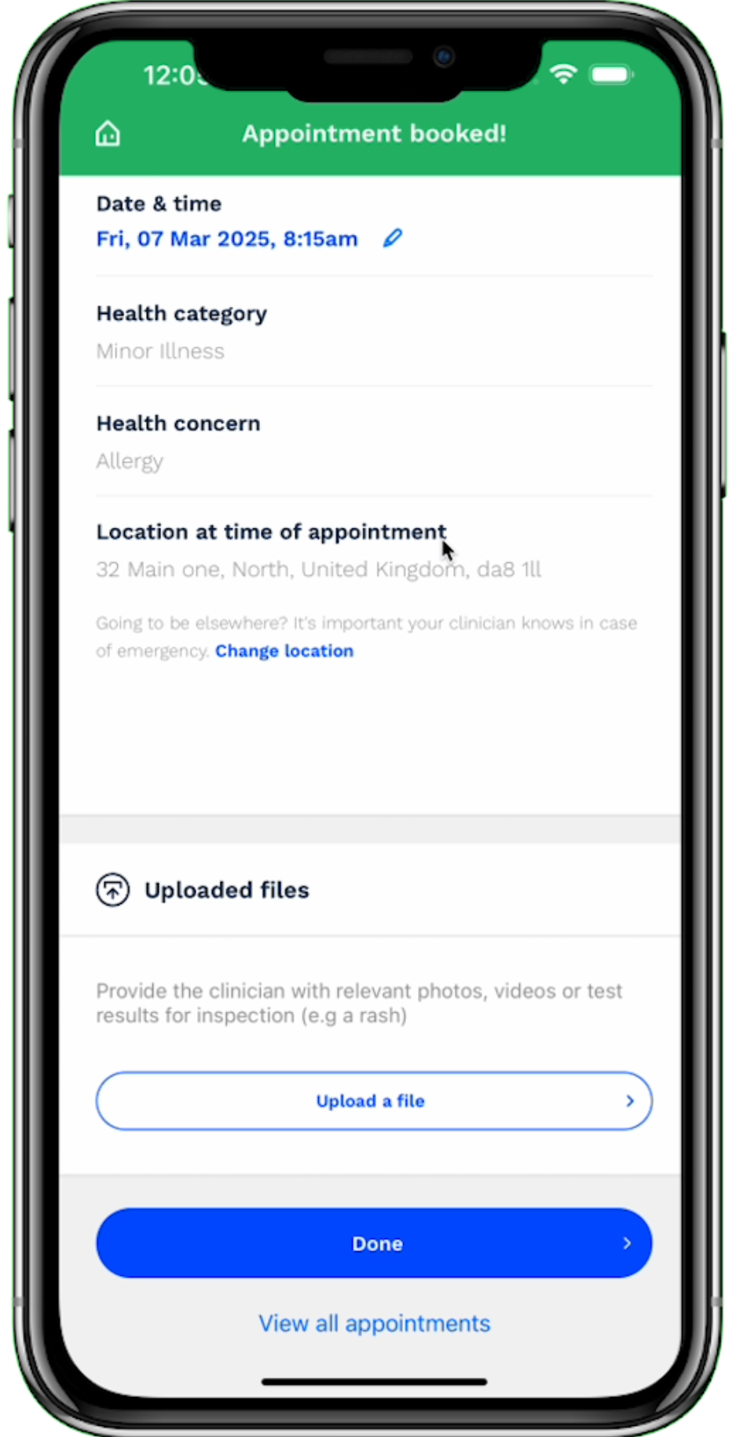
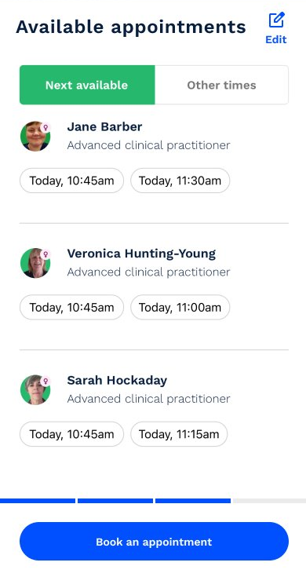
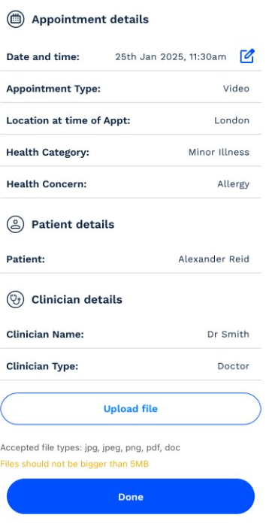
Continued…
They have the option to attach files which may help the clinician.
Choice of video or phone and clinician type
Select the clinician and time.
Appointment is booked.

Slide 11
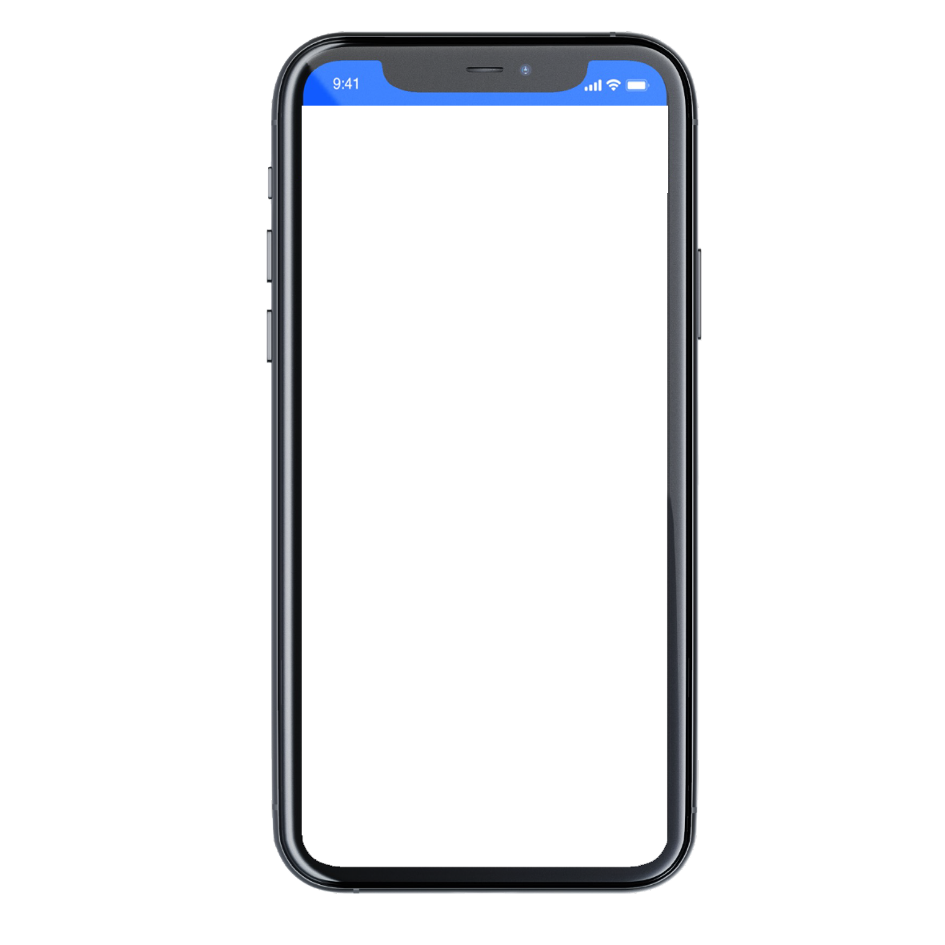
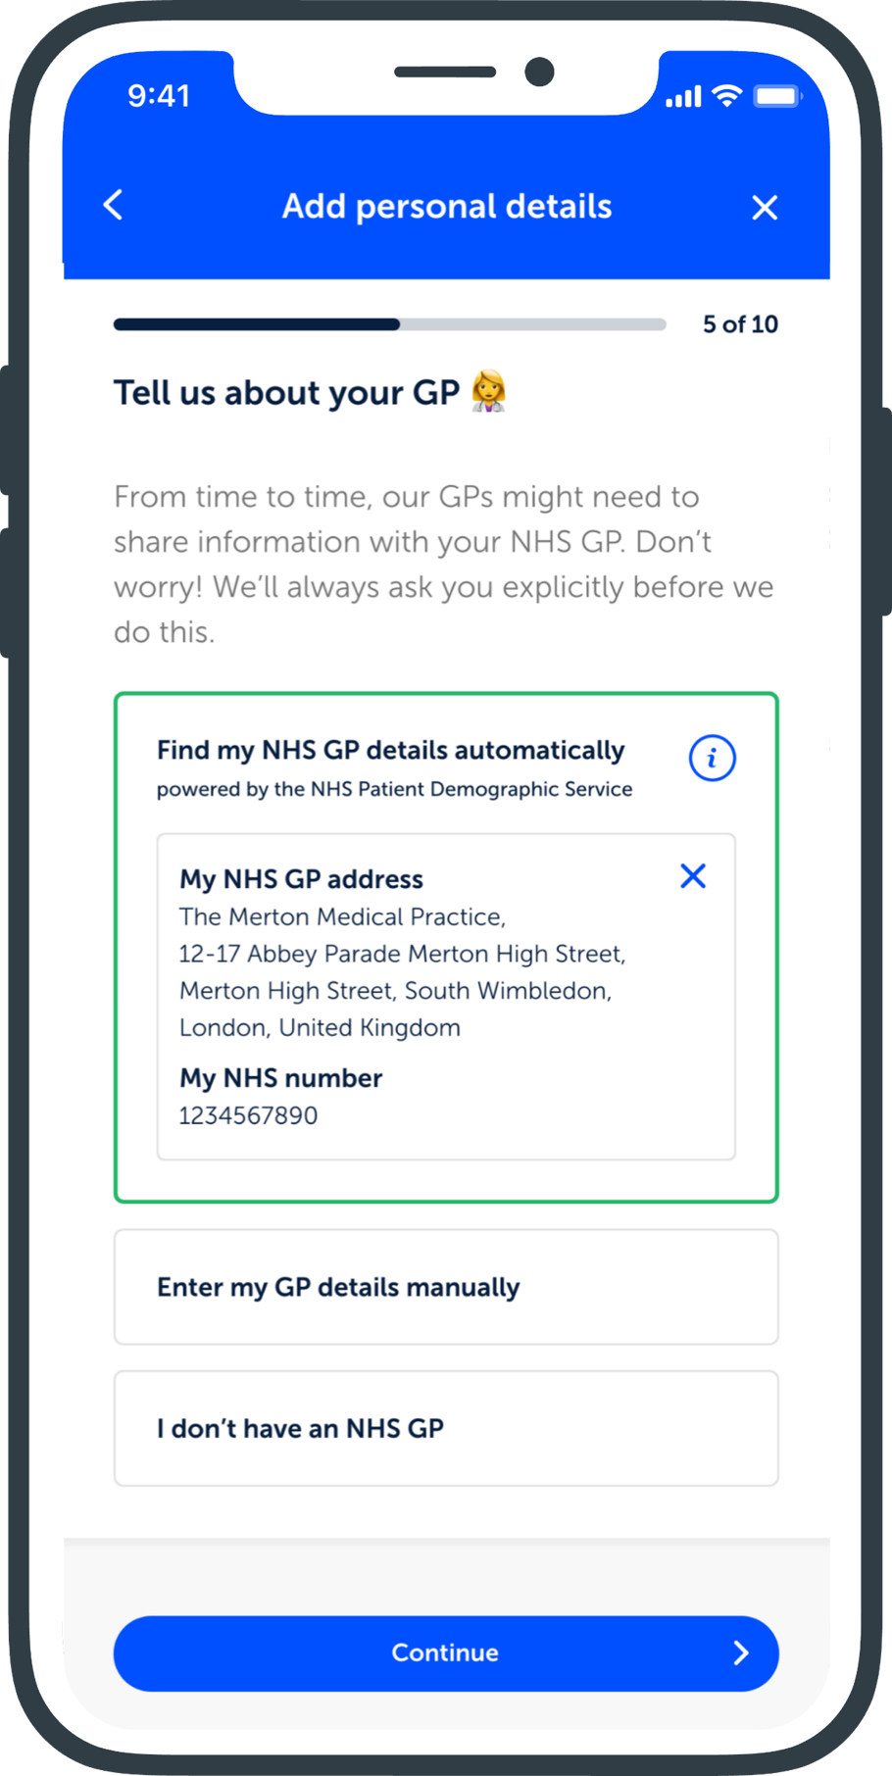
Patient Records
All the patient’s interactions with the service are held in the central patient record, which is shared with all Doctor Care Anywhere clinicians and offers the ability to share notes back to the patient’s NHS GP surgery
Single patient record available at any time
Access to previous appointment notes
Ability to update and manage medical history, allergies, medications, etc.
Patients can upload test results and photos to include in their medical record
Notes seamlessly shared with NHS GP (with patient consent) via API integration

Slide 12

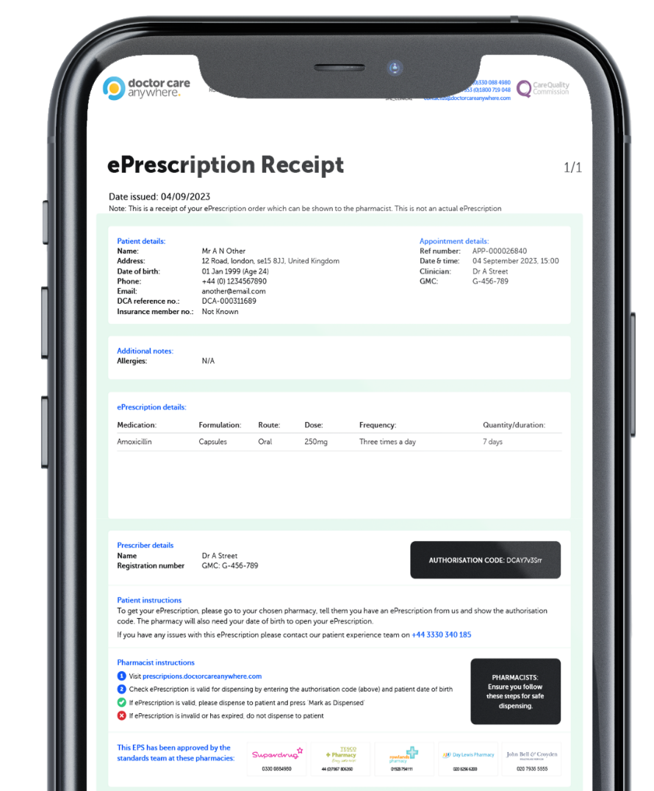
Prescriptions
If the Doctor Care Anywhere clinician needs to issue the patient with a prescription, this can all be managed through the platform – offering private prescriptions in the UK, delivered to your door or collected from your local pharmacy.
Patient can select preferred fulfilment option directly in platform
Pick up or delivery anywhere in the UK
ePrescriptions with independent and major pharmacy chains
Prescriptions can be offered through a virtual consultation with a clinician
Please note that prescription prices may differ from NHS
*Available in most circumstances. Out-patient prescriptions and deliveries are not covered by the scheme and may cost more than on the NHS. Prescriptions are only available in the UK.

Slide 13
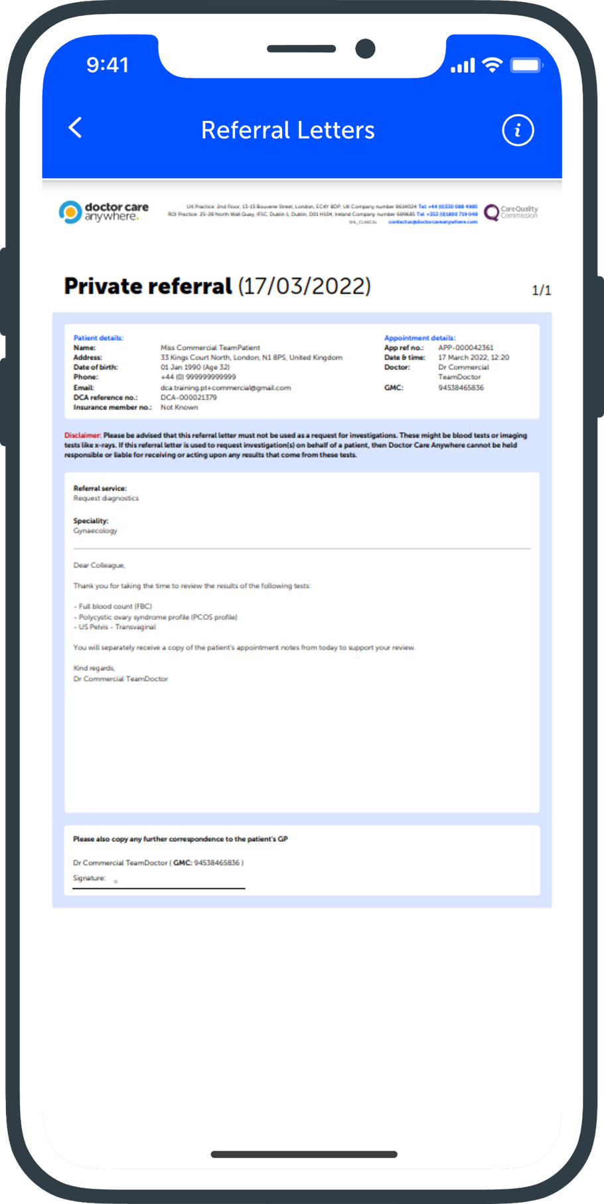
Referrals
Doctor Care Anywhere can provide private open referrals, accepted by all major private medical insurers,
Integrated referrals
Recognised by all major insurers
Fit notes
Access to Scans, Mental Health support and Blood tests

Slide 14
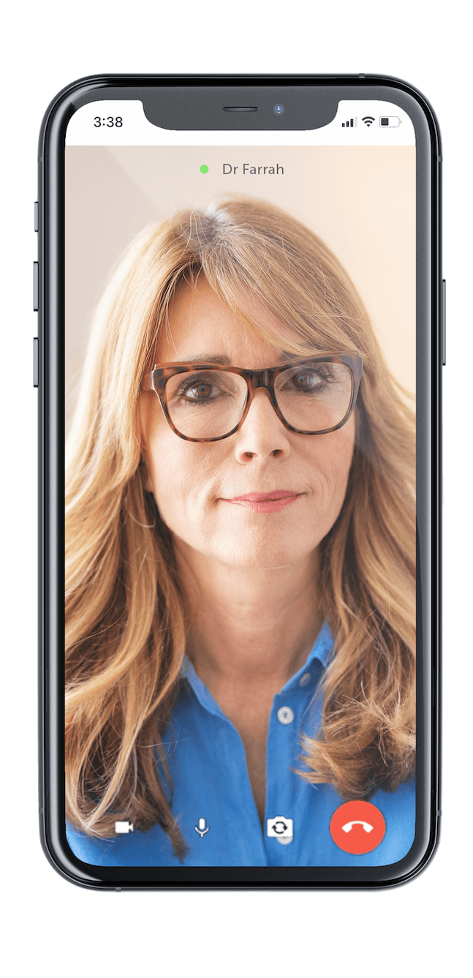
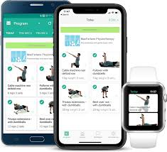

Our digital MSK care program
Entry point
Navigation
Consultation with Physio
Treatment Pathway
Digital Exercise Programme

Slide 15


Testimonials | What do patients say about us?
“I needed kindness and a safe space. Dr Afsal provided that. I am forever grateful”
“Dr Cecilia was lovely, a kind and active listener. I felt heard and she was very helpful”
“Very easy to talk to and was given time to talk and think things through which I do find hard when stressed out, so was appreciated.”
“Amazing service - not rushed, doctors really listen and help. There was a 3 week wait to see my GP so this really put my mind at ease”
”Doctor care anywhere is an incredibly useful tool - your doctors are great, responsive and engaged. Absolutely outstanding - thank you!”
Confidential. Skin Analytics 2024

